Slide 1
INDIA - US Trade
Economics

Slide 2
Contents:
India-US Relation.
Trading opportunities in both the countries.
How this two countries catch up this opportunities.
Case study of an India company which is successful in US and US company which is well establish and successful in India.
How both the governments play a vital role for supporting the trading
What are the factors that affect the trading in both the nations
The major trading sectors for both the countries and it’s scopes
Case study in education sector and then analyze it’s effect on both the nation.
Case study : India’s contribution in USA’s IT sector.

Slide 3
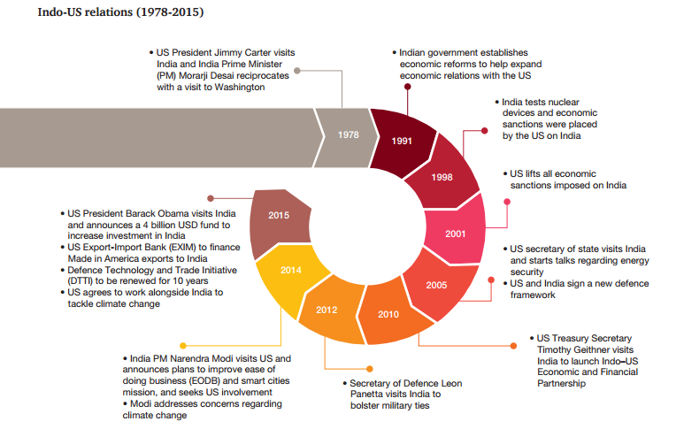

Slide 4

India
Indian economy has been one of the fast growing economy of the world. It is third largest economy in the world in terms of purchasing power.
India has immense geographical advantage as a hub for serving the South Asian, Middle East, European and African markets
With a well developed financial system, young and qualified labour force, dynamic private sector, growing savings and investment rate
Both trade and investment are playing a big role in driving economic growth. Trade accounts for 43% of GDP right now. Our objective is faster and inclusive growth.

Slide 5
India’s top trading partners (in US$ billion)
Rank | Country | Export | Import | Total Trade
1 | China | 11.94 | 60.41 | 72.35
2 | USA | 42.45 | 21.82 | 64.27
3 | UAE | 33.03 | 26.01 | 59.04
4 | Saudi Arabia | 11.17 | 28.24 | 39.41
5 | Switzerland | 1.07 | 22.13 | 23.2
6 | Germany | 7.54 | 12.79 | 20.33
7 | Hong Kong | 13.6 | 5.57 | 19.17
8 | Indonesia | 4.04 | 15 | 19.04
9 | South Korea | 4.6 | 13.53 | 18.13
10 | Singapore | 10 | 7.12 | 17.12
Total |  | 310.57 | 447.98 | 758.55

Slide 6

USA
It stands first in top ten economies of world in terms of GDP.
USA is a “free enterprise” economy.
A free enterprise is an economic system where few restrictions are placed on business activities and ownership.
In this system, governments generally have minimal ownership of enterprises in the market place.

Slide 7
USA’s top trading partners
Rank | Country | Export | Import | Total Trade
1 | Canada | 312 | 346.1 | 658.1
2 | China | 124 | 466.7 | 590.7
3 | Mexico | 240.3 | 294.2 | 534.5
4 | Japan | 67 | 133.9 | 200.9
5 | Germany | 49.4 | 123.2 | 172.6
6 | South Korea | 44.5 | 69.6 | 114.1
7 | United Kingdom | 59.9 | 54 | 107.9
8 | France | 31.2 | 47 | 78.2
9 | Brazil | 42.4 | 30.3 | 72.8
11 | India | 21.6 | 45.2 | 66.9

Slide 8
India And USA- Bilateral Trade
USA has favourable terms of International trade
Bilateral trade is led by India each year

Slide 9
% of Imports from USA (Year 14-15)
India Mainly imports aircrafts, boilers as well as electrical machinery

Slide 10
% of Export to USA (Year 14-15)
Exports mainly consists of products like pearls, precious stones, minerals and fuels

Slide 11
US Investment in India

Slide 12
Trade opportunities in India
Huge Population : Indian growth likely to remain around 8% for the next few years, while the US is likely to grow around 3%.
Economical Status as a country: Expect India to be the 3rd largest economy after the US and China by 2030
Progress in GDP year by year : India ranks 9th in the world in terms of GDP at current prices, with a market size estimated to be at US$ 2.01 trillion for the year 2014 compared to US$ 1.84 trillion in 2013.
Government Efforts: Government's effort to improve ease of doing business and relaxation in FDI norms is expected to yield results. Return on investments expected to be much higher in a fast growing market
Skill gap and level of Productivity : The productivity levels in India are one-tenth of the levels in the US. Skill gap of about 347 million people in 20 high-growth sectors (infrastructure, IT, capital goods, auto motives, telecom etc)

Slide 13
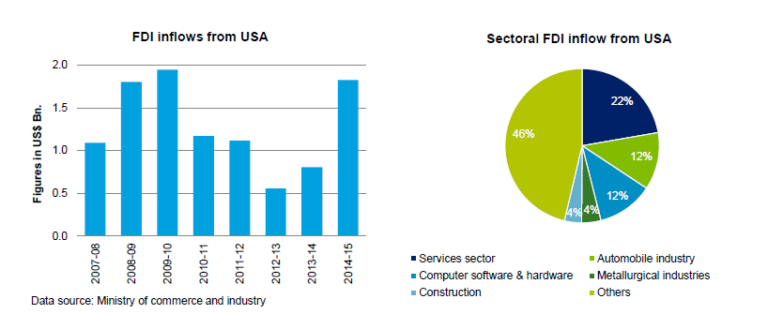
US – Investment Flows in India
US is the sixth largest investor in India.
US investment into India is predominantly focused on the services sector, with a percentage share of 22%, followed by the automobile and computer segment with a percentage share of 12% respectively

Slide 14
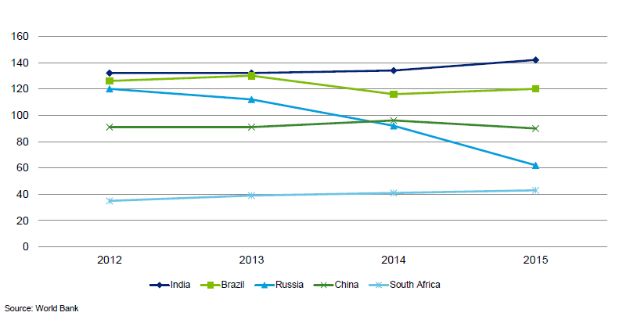
Ease of doing Business in India
India currently placed 142 out of 189 countries .

Slide 15
American Companies in India
Agilent
Agro Tech
American Express
Amway
Avaya
Caltex
Caterpillar
CB Richard Ellis
Cisco
Citigroup
Coca Cola
Cognizant
Colgate Palmolive
CSC
Cummins
Discovery
Dupont
Metlife India
Microsoft
EDS
Eli Lilly
Emerson Electric
EXL
Federal Express
Ford
Franklin Templeton
General Motors
Gillette
Honeywell India
Intel
Johnson & Johnson
JPMorgan
Kellogg India
Kimberly Clark
Kodak
McDonalds
Morgan Stanley
New York Life
Ogilvy and Mather
Oracle
Pepsico
Pfizer
Pizza Hut
Sun Microsystems
Texas
Tecumseh
Timex
Tyco
UPS India
Visteon
Whirlpool
Xerox Modicorp
These all companies play a vital role in trading between this two countries.

Slide 16
US Companies impact on India
Ford Motor Company (FMC)
Invested more than $5 million in India
Employs- 2000
CISCO
Invested over $150 million
Employs - 11,800+
*There are many more companies……………
Conclusion: The companies not only invest their money but also help in employment too , which is one of the basic need to overcome from unemployment in country like India

Slide 17
Success Story of a US Company in India

Slide 18
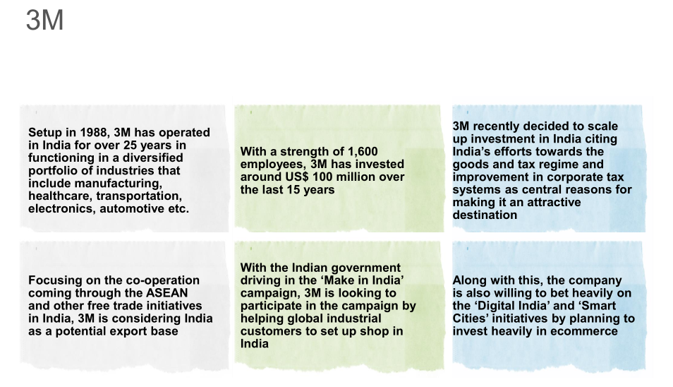
3M

Slide 19
Indian Investment in US

Slide 20
Trade opportunities in US
Economy
Ranks First in terms of GDP
Less govt. interference in making economic decisions
It is most competitive, innovative and open economy in the world
Consumer Market
USA accounts for 42 % of the global consumer goods market
It maintains free trade agreements with 14 partner countries
Also it has bilateral investment treaties in force with 40 partner countries
Thus it gives foreign investors access to additional markets worldwide
Research and Development
There is lot of research and development going on in several fields like technology, science, business etc. due to presence of excellent Universities and Institutions there
Thus it provides new business opportunities and fields
Technology
The technology in the USA is unmatched in the world
These technologies helps so much to expand business and trade

Slide 21
Contd.
Intellectual Property Rights Protection
It provides great patent services
Education
The US has very high standard of education with very renowned universities like MIT
Thus it provides very talented human resources
Productive Workforce
American workers are highly trained
They are quick to use and capitalize on innovative technologies to improve productivity
Govt. spends billions of $ every year to train the workforces to use new technologies
Transportation and Infrastructure
United States has the largest roadway system, railway network, and number of airports of top 10 economic powers.
Reduced corporate taxes

Slide 22
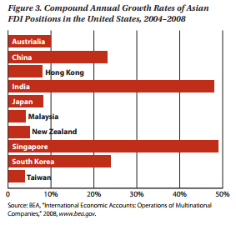
Different Countries – Investment Flows in US
India Stands second in this list after Singapore.

Slide 23

Indian Contributions to USA
As of 2013, USA is exporting $ 23.457 Billion worth of goods and services to India. Major Contributor is Travel Sector.

Slide 24
Indian Companies Investments in USA
Data Source
Some key figures:-
Indian Companies have altogether invested $ 15 Billion as FDI in USA.
They have employed to nearly 90,000 US Citizens across whole country
Still Investment is Increasing.
There has been many Acquisitions of US companies by Indian companies like as shown in next slide:-

Slide 25
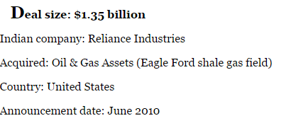
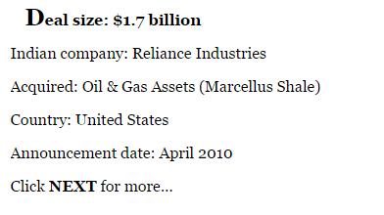
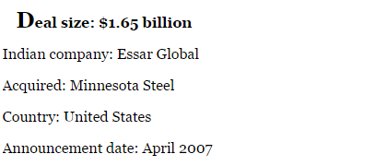
There are many more beside this…..

Slide 26
Success Story of an Indian Company in US

Slide 27
The Tata Group
The Tata Group has 12 companies and more than 16,000 employees in the United States and Canada.
Tata companies are benefiting the American economy in diverse ways-through the creation of jobs, by way of taxes paid, through direct and indirect investments, and by providing productivity boosts.
Tata companies own some of the most recognized brands in North America, including Tetley Tea, Good Earth, Eight O'clock Coffee, The Pierre Hotel in New York and the Campton Place Hotel in San Francisco.
Tata Motors and Tata Communications trade shares on the New York Stock Exchange.
The TCS a Subsidiary of The Tata Group has also done good achievements in US as shown in Next Slide:-

Slide 28
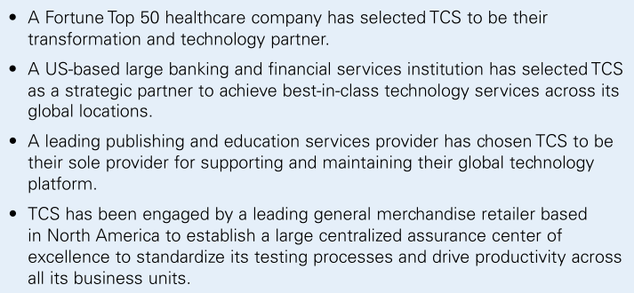
Achievements by TCS in USA

Slide 29


To catch the attractive opportunities both the governments play a vital role.
Let’s see

Slide 30
National Export Initiative
Trading Support by the US Government
President Barack Obama announced the National Export Initiative in his January 2010 State of the Union Address.
“So tonight, we set a new goal: We will double our exports over the next five years, an increase that will support two million jobs in America.”
President Obama
State of the Union
January 27, 2010

Slide 31
In 2008, US exports reached the highest level since the 1870’s contributing 13% of total US GDP
and supported 10.3 million jobs. The economic recession of the past two years temporarily Halted this significant growth.
The NEI is a part of a long-term growth strategy to reverse the trend of the past two years

Slide 32
Access to Credit: The Export-Import Bank has increased its loan approvals by nearly 20% thus far this fiscal year (11 months to Aug 2010) over the same period last fiscal year, from $18.3 billion to $21.5 billion. Small business approvals have increased from $3.6 billion to $4.1 billion. The estimated total number of U.S. jobs supported by Ex-Im Bank financing has increased from 170,000 to 200,000 over this period.
Trade Advocacy: The Advocacy Center has assisted US companies competing for international contracts and other exporting opportunities to support $13.4 billion in US export content since the announcement of the NEI,. These projects support an estimated 70,000 jobs.
Export Promotion: The Department of Commerce has increased trade missions and reverse trade missions, which connect buyers and sellers to one another, in hopes of securing successful business deals. This year alone, Commerce has led 28trade missions with companies anticipating approximately $2 billion in export sales.
Barriers to Trade: Efforts by USTR and other agencies to remove trade barriers are having results, including signing an agreement with China to reopen a pork market worth $250 million.

Slide 33
Increase access to export financing to ensure good opportunities do not fall through the cracks.
Promote policies that lead to strong, sustainable and balanced economic growth.
Reduce trade barriers in order to open as many new markets as possible.
Improve trade advocacy and trade promotion efforts on behalf of U.S exporters.
Robustly enforce trade rules to ensure our trading partners live up to their obligations.

Slide 34
Trading Support by the Indian Government
Improving the ease for doing business
Financial inclusions
Make in India
Skill India
Smart Cities
Digital India

Slide 35
Initiatives to encourage Indian Companies for foreign trade
The RBI has relaxed norms for foreign investment by Indian business by:-
Removing the ceiling for raising funds through pledge of shares, domestic and overseas assets for companies doing abroad investments
Raising the borrowing limit

Slide 36
Contd.
Facilitated unlisted Indian companies to list on foreign markets without having to be publicly traded on domestic exchanges to raise the funds abroad.
"The duty drawback scheme has been widened and deepened to include more products and countries. The government will continue to take measures to support the export sector," Finance Minister ‘Arun Jaitley’ said in the Budget for 2016-17.
In a result of this, means according to Budget 2016-17
The minister proposed to amend the Customs Act to provide for deferred payment of customs duties for importers and exporters with proven track record and to increase the limitation period from one year to two year in cases not involving fraud, suppression of facts and willful mis-statement. The government also plans to extend the facility of direct port delivery to more importer

Slide 37
Factors affecting India US Trade
Technical Barriers
Sanitary and Phytosanitary Barriers
Import Polices
Tariffs and other Charges on Imports
Import Licenses
Customers’ Mentality
Government Procurement
Export Subsidies
Agriculture Programs
Investment barriers
Education
Legal Services
Reference : https://ustr.gov/sites/default/files/files/reports/2015/NTE/2015%20NTE%20India.pdf

Slide 38
Major Trading Sectors Between India and US

Slide 39
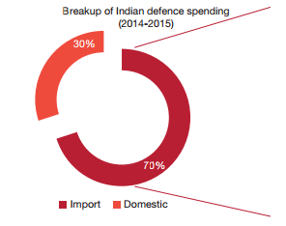
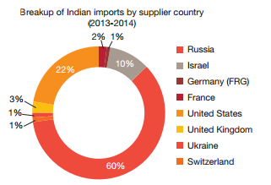
Aerospace and Defence
The A&D sector, in spite of contributing only 1.2 billion USD of the 100 billion USD trade, can be crucial in driving Indo-US trade and strategic ties as it rapidly increases in both size and share.
. If the US becomes India’s premier trading partner in the defence sector, trade can reach up to 25 billion USD and more.
US is India’s second-largest defence equipment supplier.

Slide 40
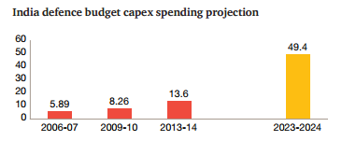
Key opportunities in Indo-US defence trade
The US and Indian government’s plan to jointly research and develop a next-generation protective suit for troops working in biohazardous environments, thus offering opportunities for future trade.
They are working towards developing unmanned aircraft vehicle (UAVs) and aircraft, opening up trade opportunity
With the Make in India initiative, the Indian government is looking to build a manufacturing ecosystem for various sectors in the country. This presents an opportunity for Indian companies to improve their quality and technological expertise to become a part of the global supply chain of foreign defence players.

Slide 41
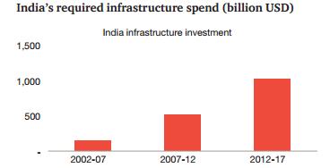
Infrastructure and logistics
India’s infrastructure and network of transportation forms the backbone of the economy. To sustain the momentum of rapid economic growth, India needs to improve its physical connectivity and infrastructure to the level found in some of its competitive nations. It requires an expansion of state and national highways, an improvement in freight-handling capacities, primarily through railways, and needs to shift to third-party logistics systems.
India has a very high level of logistics cost 13% of GDP as compared to 8% in most of the developed countries. A key reason behind this is the population’s high dependency on outdated rail and road networks.

Slide 42
Key opportunities in infrastructure
Opportunity exists for US firms to participate in the design, development, project management and information and communications technology (ICT) development activities in the upcoming smart cities in India and also modernise the infrastructure in existing urban centres.
To support rapid urbanisation, the Indian government needs to upgrade transportation infrastructure such as railway. US firms can provide their expertise as well as invest in metros and monorails across growing cities.
The Indian government is trying to attract investment in the infrastructure space from foreign pension funds. US pension fund investments can look at recalibrating the PPP model often used in Indian infrastructure development to supplement government financing.

Slide 43
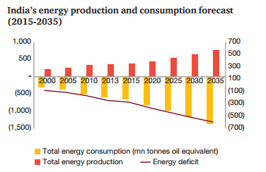
Energy
Today, more than 300 million people in India do not have access to electricity. The need for power, driven by the increase in manufacturing, urbanisation and mechanised agriculture, is expected to rise. The current power consumption in India is 672 kWh per capita, which is much lower than its global counterparts. By 2034, India can make power accessible to 100% of its population and increase the per capita consumption up to 1,800 kWh per capita. This will require diversification of its energy mix and adoption of new technologies.

Slide 44
Key opportunities in Energy
With India’s consumption of coal and oil as sources of energy shifting to natural gas, and the US surplus of shale gas resources expected in the future, opportunity exists for shale gas trade.
According to PwC’s Future of India report, around 24-30% of power generated in India is lost during transmission and distribution. Technology transfer from US companies can help identify and reduce these losses.

Slide 45
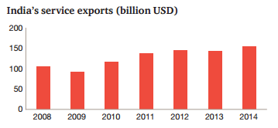
Services
The service sector has played a major role in India’s growth over the past two decades and contributes to 53% of the GDP. The service trade between India and the US has grown 930% since 2002 and currently stands at 34 billion USD. The potential for increasing this further is vast and critical in achieving the 500 billion USD target for the total Indo-US trade.
The size of the US economy makes it the largest importer of commercial services, accounting for 10% of the total global service imports.58 This aligns with India’s increasing service export market which is currently the sixth-largest in the world. The rapid growth of India’s commercial services export is evident from its rise from 92 billion USD in 2009 to 155 billion USD today. India, at present, accounts for 3% of the total export of services around the globe.

Slide 46
Key opportunities in the services sector
India needs to invest in IT R&D to add value to its offerings. To strengthen this sector, Indian IT companies need to focus on the following:
Big data and machine to machine (M2M) technology. These new areas will help India grow its service trade.
Digital transformation impacting B2B, B2C, B2G. This offers a great opportunity for India-based companies.
The tech start-up ecosystem in India is now having global model mindset wherein they are scaling up to serve the global markets (e.g. Zomato, Cardekho, etc). With Indian start-up ecosystem becoming more vibrant, it offers opportunity for US based venture capital funds to invest in the segment

Slide 47
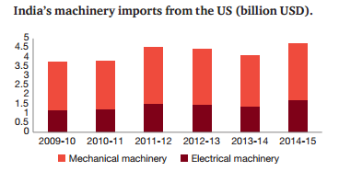
Manufacturing
With the growth of urban India and the rapid industrialisation across sectors, manufacturing will play a vital role in India’s development. Shifting focus from low-tech to high-tech industries is critical. It is also important to climb up the value chain and shift the focus to value added products. To emerge as a dominant force in the world market, India will need to increase its value-added manufacturing from 12% of the GDP to 25%.

Slide 48
Key Opportunities in Manufacturing
As the Indian government increases its focus on developing a manufacturing hub in India, opportunity exists for US companies to participate in the sector through their technological expertise, especially in sectors like gems and jewellery, which are currently facing a significant technology gap.
Pharmaceuticals are one of the top imported commodities in US, while India exports pharmaceuticals to over 200 countries worldwide. This presents an opportunity for Indian pharmaceutical companies to increase trade with the US.

Slide 49
Agriculture and Agro based Products
As India is agricultural country. The trade of Agriculture and agro based products are important.
But, the there is mostly exports of agro based products to US from India, while India imports Agricultural Machineries from USA.
If we see the export numbers we find that:-
In year 2013-14 India did 5,98,376.79 MT of commodity exports to US which was of value Rs. 19,817.95 Crores.
In year 2014-15 it did exports of 6,87,660.26 MT of agricultural produce to US but this time it was of value Rs. 12,102.75 Crores.

Slide 50
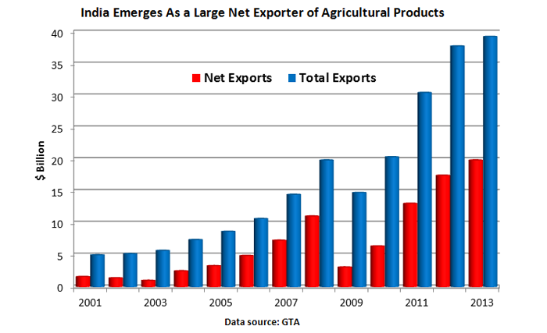
Contd.
India’s export graph is increasing in agro based products as shown below:-

Slide 51
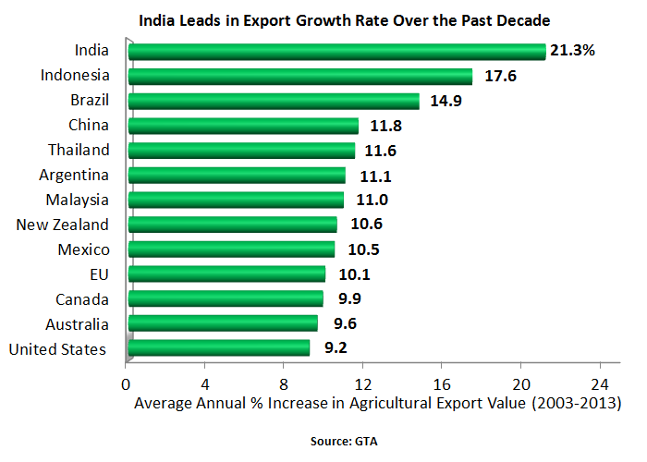
Contd.
Also as compared to other countries in the world, India exports more in agricultural products as shown below:-

Slide 52
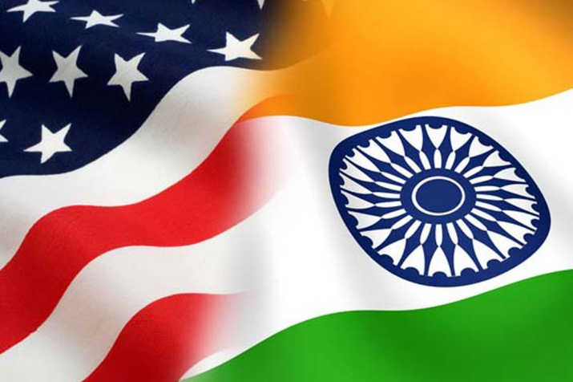

Education trade between India and US

Slide 53
Indian Students history
For the past decade, India has ranked first or second among “sending” countries, along with China.
In 2013/2014, India sent 102,673 students to the United States.
Over the last 15 years, the number of Indian students that have go to the United States has varied between 37,482 in 1998/99 and 104,897 in 2009/10.
Over the 15 year period, the number of Indian students increased by 174 percent. The more recent trend is stability.
Roughly 60 percent of Indian students in the United States are graduate students, while 12 percent are undergraduates. Students in Optional Practical Training and “Other” disciplines make up the remainder.
Most students from India (79 percent) study STEM subjects and the states hosting the largest number of Indian STEM students are California, Texas, and New York.

Slide 54
United States is the Destination of Choice for Indian Students
According to the OECD, United States stands first as a student choice with 44.7 percent of students, the second largest destination was the United Kingdom with 17.4 percent.
Canada was the third most popular country, recruiting 6.5 percent of internationally mobile Indian students.
- OECD(Organization for Economic Co-operation and Development )

Slide 55
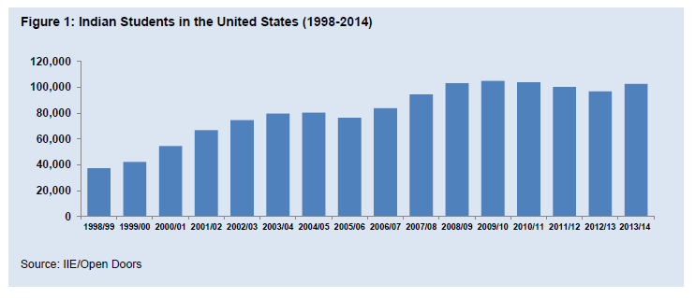

Slide 56
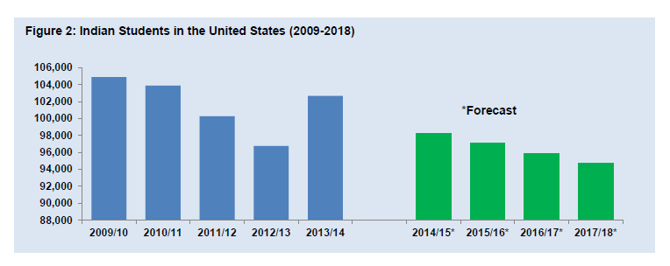
In 2001, the United States was host to 76 percent of all Indian students studying abroad. This number has fallen to 45 percent in 2012.
Reason:
The United States has lost out to universities in the United Kingdom, Canada, and New Zealand.

Slide 57
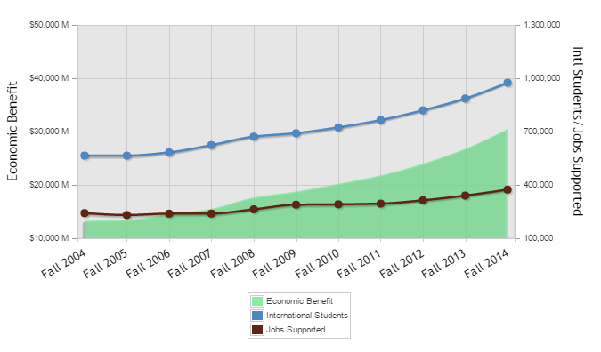
US benefits by international Students
Source :- NAFSA

Slide 58
Economic impact of foreign education on U.S
In 2015, the continued growth in international students coming to the U.S. for higher education had a significant positive economic impact on the United States. International students contributed more than $30.5 billion to the U.S. economy, according to the U.S. Department of Commerce.
Students from around the world who study in the United States also contribute to America's scientific and technical research and bring international perspectives into U.S. classrooms, helping prepare American undergraduates for global careers, and often lead to longer-term business relationships and economic benefits.

Slide 59
Economic impact of foreign education on India
India mainly looses its youth power, due to less advancement in education ,technological sector and the third main thing , India is still a developing nation so it won’t have that much opportunities which other developed countries have.
Remedies :
India has to develop the above sectors and generate the confidence in youth, also if India has to make certain polies which will attract the foreign countries to provide their education in India with same quality, not only just an education but also try to develop in its all major sectors.

Slide 60
Benefits of foreign education in India
Sustaining intelligent minds
India can retain its brilliant minds for its growth and development.
Greater research
The foreign education can make a world of a difference to Indian students, encouraging them for better research and by also providing adequate funds for better quality research.
No change in Indian cultures
By staying in the home country and getting the same high quality education for less money, the entry of foreign universities in India is a boon to the entire nation.
Increase in employment
the level of employment will increase drastically. Both the educated as well as the non educated segment of the country will be put to jobs and manpower will be utilized efficiently.
Overall it will become the main base(Youth power)and with that base India will be soon in Developed nation list

Slide 61
Case study : India’s contribution in USA’s IT sector

Slide 62
India has a huge pool of English-speaking IT professionals.
This is why the English-speaking countries like the US and the UK depend on the Indian IT industry for outsourcing their business processes.
The third of fourth graduates in computer science from prestigious IITs are in working in US based top tech companies.
Indian tech industry contributed nearly 411,000 jobs to the US economy this year and $20 billion in taxes between 2011-15 when American firms leveraged Indian talent to provide innovative and cost-competitive solutions to boost their global market share, a new report said today.
The National Association of Software and Services Companies (NASSCOM) president R Chandrashekhar said Indian tech industry contributed more than $375 million to the US Treasury between fiscal year 2011-2015, and also helped America secure its borders.
These benefits included $2 billion in investments, hundreds of thousands of new jobs for Americans, $20 billion in taxes, and more than 120,000 American lives touched through philanthropic work supported by Indian organisations.

Slide 63
4 out of 10 Silicon Valley start ups are run by Indians.
The proportion of Indian-founded start ups in Silicon Valley start ups has increased from 7% to 15.5% from 1999 to 2012 even though Indians make up just 6% of the Valley’s working population.
NASA, 36% or almost 4 out of 10 scientists are Indians.
34% employees at Microsoft, 28% at IBM, 17% at Intel and 13% at Xerox are Indians.
Indian’s head and shoulder is higher than compare to other world.

Slide 64


Slide 65
Workforce of India in US
The two labour markets are enormous. The combined formal labour markets exceed 200 million people. The combined informal labour markets, dominated by India, exceed 400 million people.
Indians Working in the U.S. In 2006, there were 1.5 million Indian-born individuals living in the U.S., of whom 42 % were U.S. citizens. Generally speaking, these immigrants were highly skilled, with 74 % possessing a bachelor's degree and 41 % possessing an advanced degree, numbers that dwarf U.S. averages.
As of 2010, there were more than 2.9 million people of Indian origin in America with a decadal growth rate of 69 %. While the data does not distinguish according to work status, it does show that 60 % of lawful permanent Indian-born residents in America work in managerial positions.

Slide 66
ethnic Indians who are now in the U.S. but born elsewhere, 30 % work in science and engineering, while another 5 % are physicians. In the grand scheme of the U.S. labour market, most Indian immigrants are job creators.
They are entrepreneurs or people who add to the U.S. economy with their skills, rather than "job-takers“.
Indian doctors, numbering more than 35,000, constitute over five % of all physicians in America.
12% scientists and 38% doctors in the US are Indians.
Indians also own nearly 40% of all the small and mid-size hotels in the country.

Slide 67
Done by:
Maunil Vyas 1401007
Deep Patel 1401010
Shreyas Patel 1401025
Jay Dangar 1401043
Pratham Solanki 1401049
Ashutosh Kakadiya 1401075
Deep Talati 1401085
Harsh Mehta 1401086
Kishan Raval 1401117

Slide 68
Thank you

